Slide 1
Hack Kosice Marathon - Thermo Fisher Scientific
Detailed task specification
Notes:
This is the default title slide for Thermo Fisher Scientific
Title photo options specific to end-markets will be available via commercial overview presentations due for release 2015-2016

Slide 2
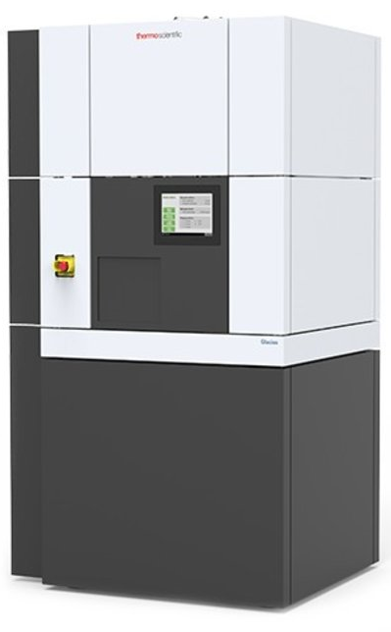
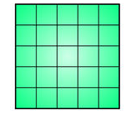
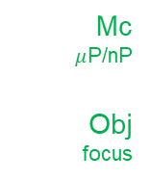
Transmission electron microscopes (TEM)
Electron gun + accelerator
Transmission electron microscopy:
Uses electron beam for imaging instead of light like in the conventional light microscopy.
TEM finds application in e.g. cancer research, virology, materials science, semiconductor production, or nanotechnology.
Electrons are generated by the electron source (mostly Field Emission Gun) and accelerated by the accelerator.
Electron beam is then guided by the microscope’s optical system (Condenser + Objective).
After passing through the examined specimen (usually a thin film of material, less than 200 nm thick), the imprinted image is magnified by the microscope’s Projector system.
Finally, the electron beam is transferred to a visual form by a camera or some other type of detector (e.g. annular detectors).
The whole complex microscope’s optical system must be „aligned“ (i.e. beam focused, properly tilted, shifted and shaped between modules) to achieve a microscope’s peak performance
Gun lens
Condenser
C1
Spot size
C2
intensity
Mc
$μ$P/nP
Obj
focus
Objective
D
I
P1
P2
Projector
Camera + detectors
Fig: Transmission electron microscope
Fig: Schematic diagram of TEM optical system
Notes:
To create a new presentation
Double-click or Open from PowerPoint > [xxxtemplate].potx file.
Start building in this template and save as a new presentation.
Avoid copy & paste or drag & drop of slides from other presentations in different templates. This often can cause master template conflicts and increased file sizes. Instead…
To leverage content from other presentations, (1) select just the content on a slide that you need (2) copy & paste into a [blank] slide in this template (3) Control pasted content appearance via the paste options button that appears immediately after a paste action and which provides the option to choose either “use destination formatting” or “maintain source formatting” of pasted content.
Applying New Template Theme to an Existing Presentation :
From the Design Tab in the ribbon, click on the “more” drop down arrow at the right of the theme ribbon
Select “Browse for Themes…”
Navigate to and select [xxxtemplate].potx file and click Apply
This will apply new Template Theme colors, fonts and layouts but will not include any of the content on the slide examples from the full template itself.
Reposition content and reapply or change layouts as needed.
Additional resources available on iConnect > Functions > Marketing > Resource Library

Slide 3
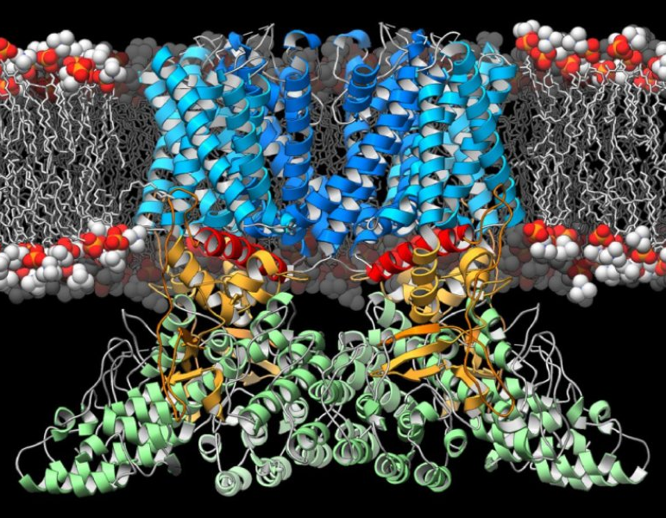

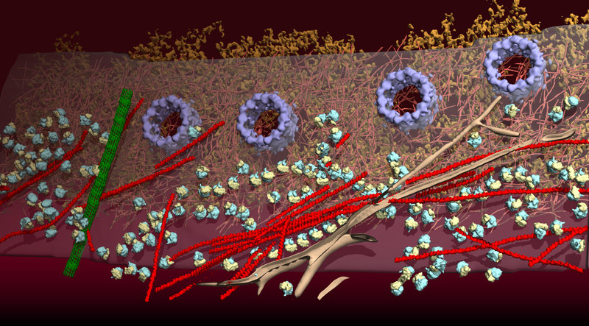
Cryogenic Electron Microscopy (what is TEM for)
Cryogenic Electron Microscopy (Cryo-EM):
A set of techniques mainly used in structural biology where the sample is investigated at cryogenic (liquid nitrogen) temperatures.
Single Particle Analysis (SPA) – complex image processing-based technique of visualization and 3D reconstruction of proteins and viruses (awarded by the Nobel Prize in Chemistry 2017).
Cryogenic Electron Tomography – technique producing 3D images of cells or macromolecules. The sample is imaged at different angles, and then the final 3D volume is reconstructed from 2D projections.
Electron Crystallography – a method for determining the arrangement of atoms in small organic/inorganic crystals.
Fig: 2017 Nobel prize in Chemistry winners.
Fig: Single particle analysis example.
Fig: Cryogenic electron tomography example.
Notes:
To create a new presentation
Double-click or Open from PowerPoint > [xxxtemplate].potx file.
Start building in this template and save as a new presentation.
Avoid copy & paste or drag & drop of slides from other presentations in different templates. This often can cause master template conflicts and increased file sizes. Instead…
To leverage content from other presentations, (1) select just the content on a slide that you need (2) copy & paste into a [blank] slide in this template (3) Control pasted content appearance via the paste options button that appears immediately after a paste action and which provides the option to choose either “use destination formatting” or “maintain source formatting” of pasted content.
Applying New Template Theme to an Existing Presentation :
From the Design Tab in the ribbon, click on the “more” drop down arrow at the right of the theme ribbon
Select “Browse for Themes…”
Navigate to and select [xxxtemplate].potx file and click Apply
This will apply new Template Theme colors, fonts and layouts but will not include any of the content on the slide examples from the full template itself.
Reposition content and reapply or change layouts as needed.
Additional resources available on iConnect > Functions > Marketing > Resource Library

Slide 4
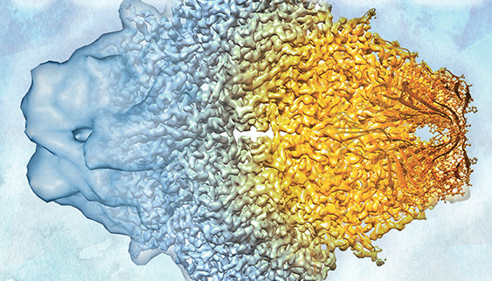
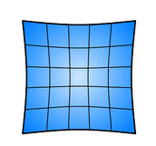
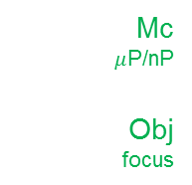
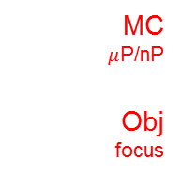
Why is a well aligned microscope needed?
Gun + acc
Gun + acc
Gun lens
Gun lens
Condenser
Condenser
C1
Spot size
C2
Intensity
C1
Spot size
C2
intensity
MC
$μ$P/nP
Obj
focus
Mc
$μ$P/nP
Obj
focus
Objective
Objective
Projective
Projective
Fig. SPA of Beta-galaktosidase protein
D
I
P1
P2
D
I
P1
P2
NOT aligned
Well aligned
Camera + detectors
Camera + detectors

Slide 5



How to achieve aligned TEM state?
Gun + acc
Gun + acc
Gun lens
Manual alignment
Gun lens
Condenser
Condenser
C1
Spot size
C2
Intensity
C1
Spot size
C2
intensity
highly experienced user required
time-consuming
not reproducible
MC
$μ$P/nP
Obj
focus
Mc
$μ$P/nP
Obj
focus
Objective
Objective
Automatic alignment
Projective
Projective
D
I
P1
P2
D
I
P1
P2
+ suitable for a wide range of users
+ fast
+ reproducible
- robust image processing algorithms required
Camera + detectors
Camera + detectors

Slide 6
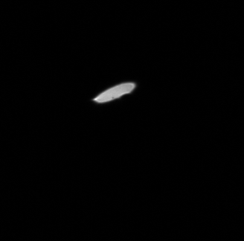
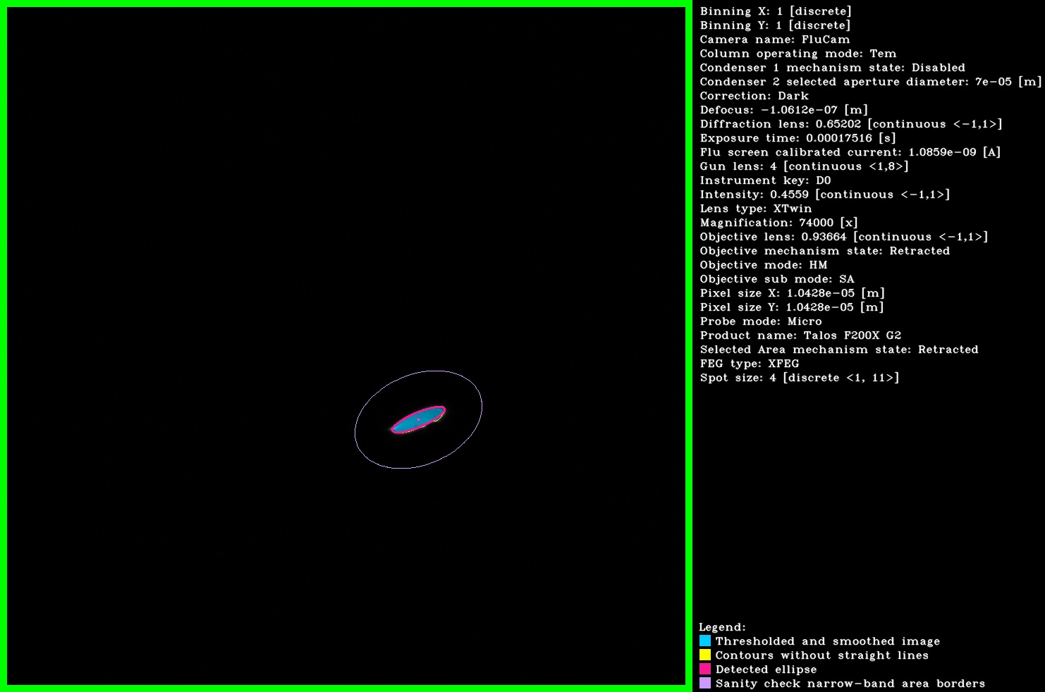
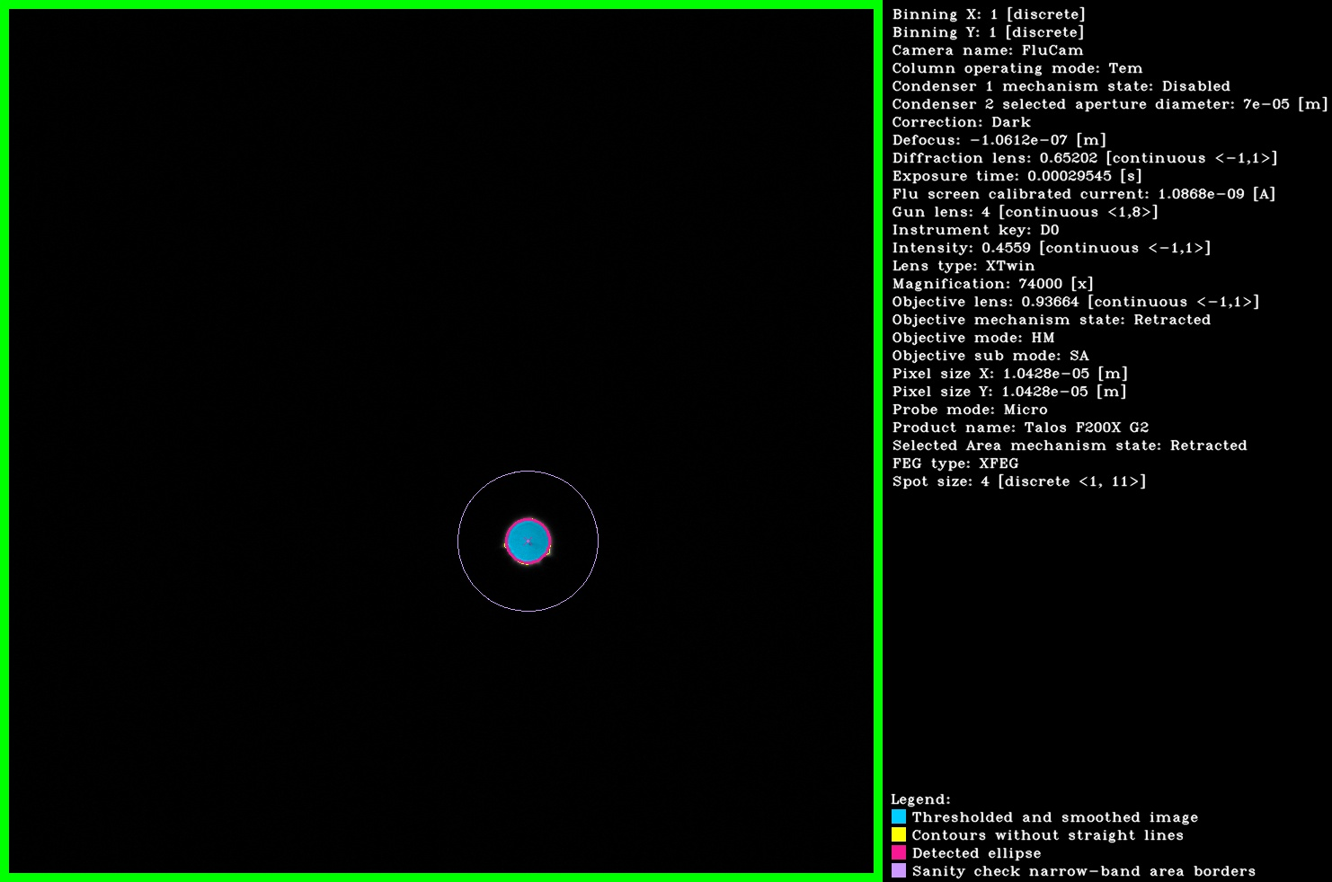
Automatized TEM alignments (why is image processing important)
Stigmation alignment – correction of astigmatism aberration
Simplified description:
An iterative procedure aiming to make an elliptic (astigmatic) beam as circular as possible (astigmatism-free).
A fitted ellipse eccentricity is used as a measure of astigmatism.
An excitation of special coils (stigmators) is iteratively adjusted to minimize the beam’s eccentricity.
Wrong/imprecise image processing (ellipse fitting) output may violate the whole alignment process.
acquisition
fitting
iterations
eccentricity
analysis
stigmators
Image acquisition
Ellipse fitting
Eccentricity minimization
Astigmatism-free beam

Slide 7
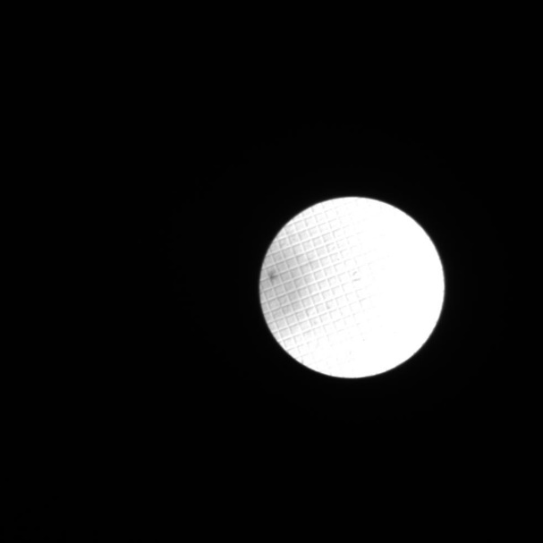
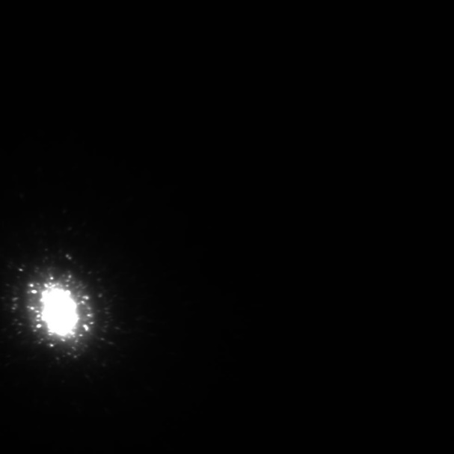
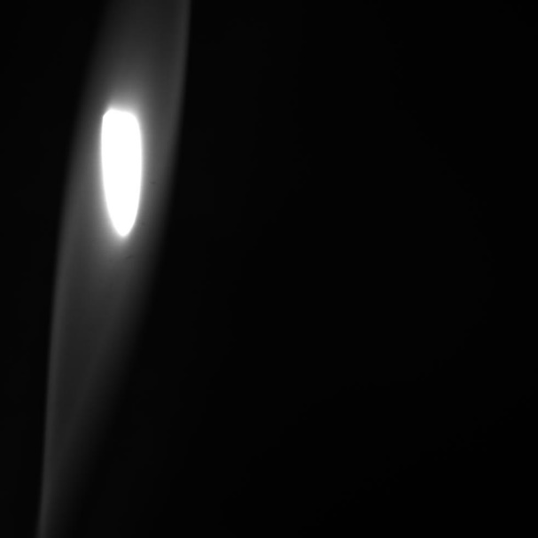
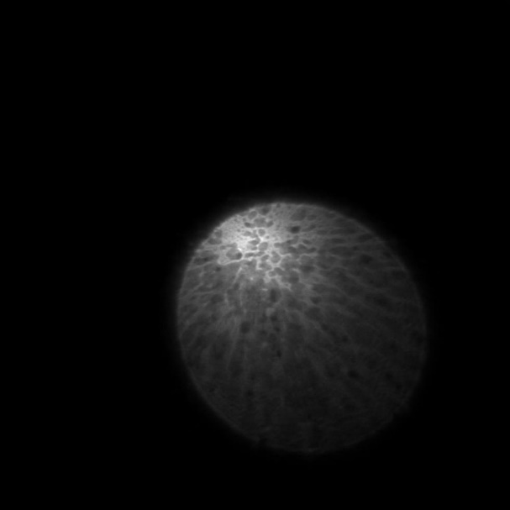
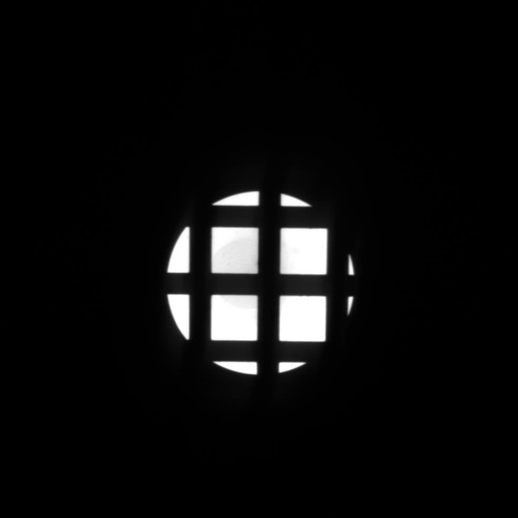
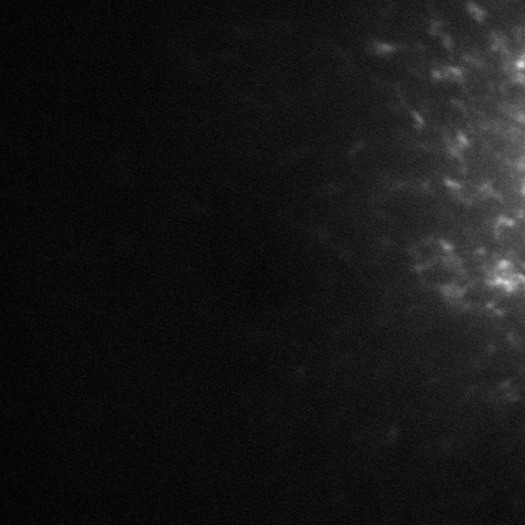
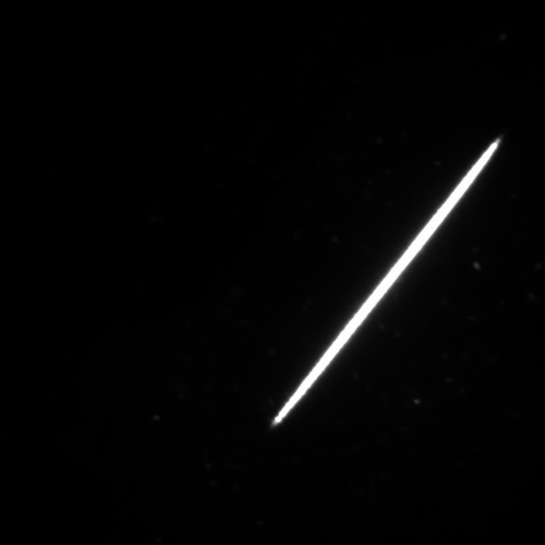
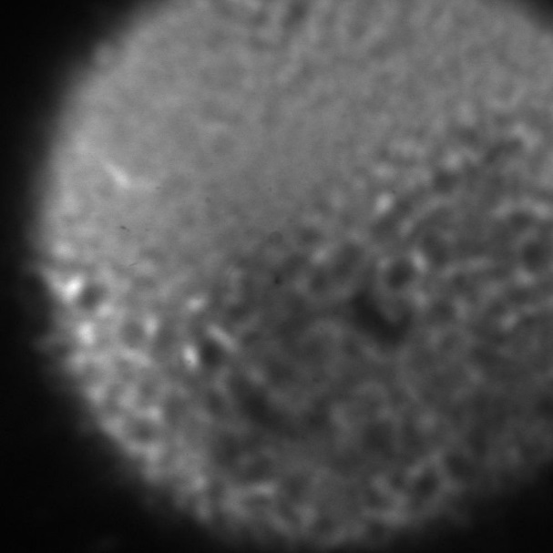
The main challenge of TEM images processing: enormous variability of the data

Slide 8
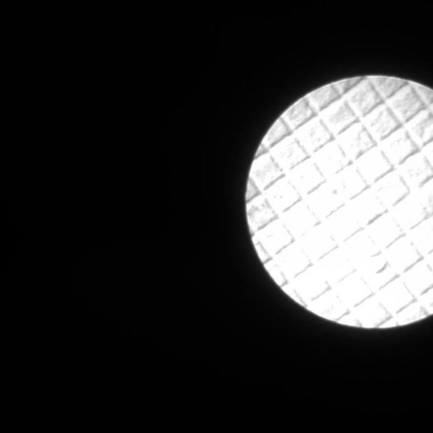
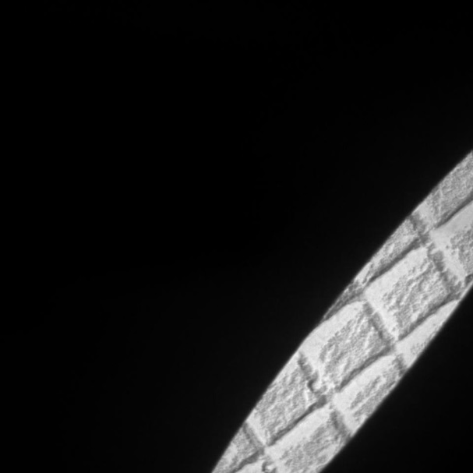
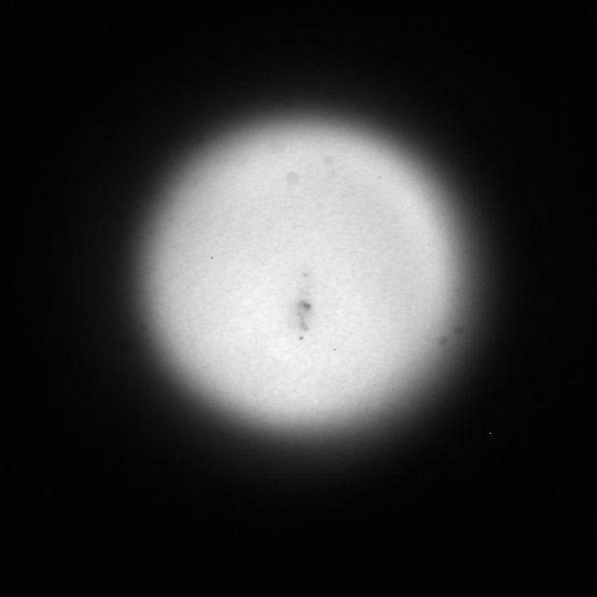
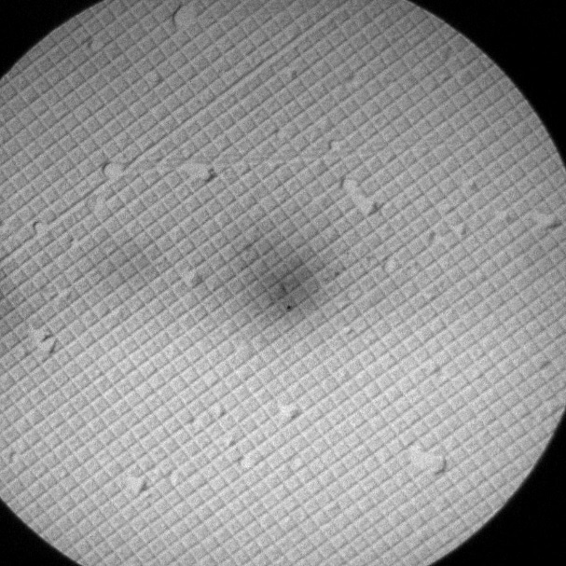
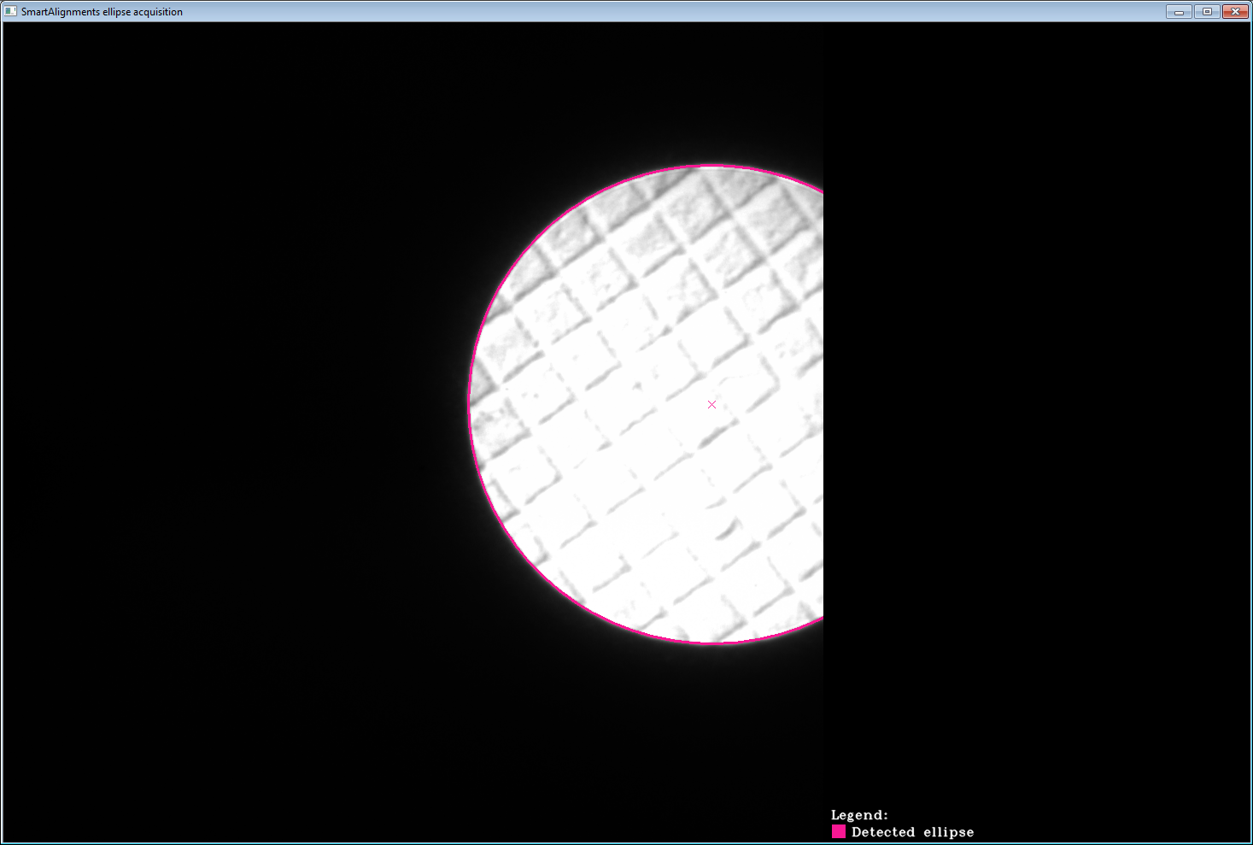
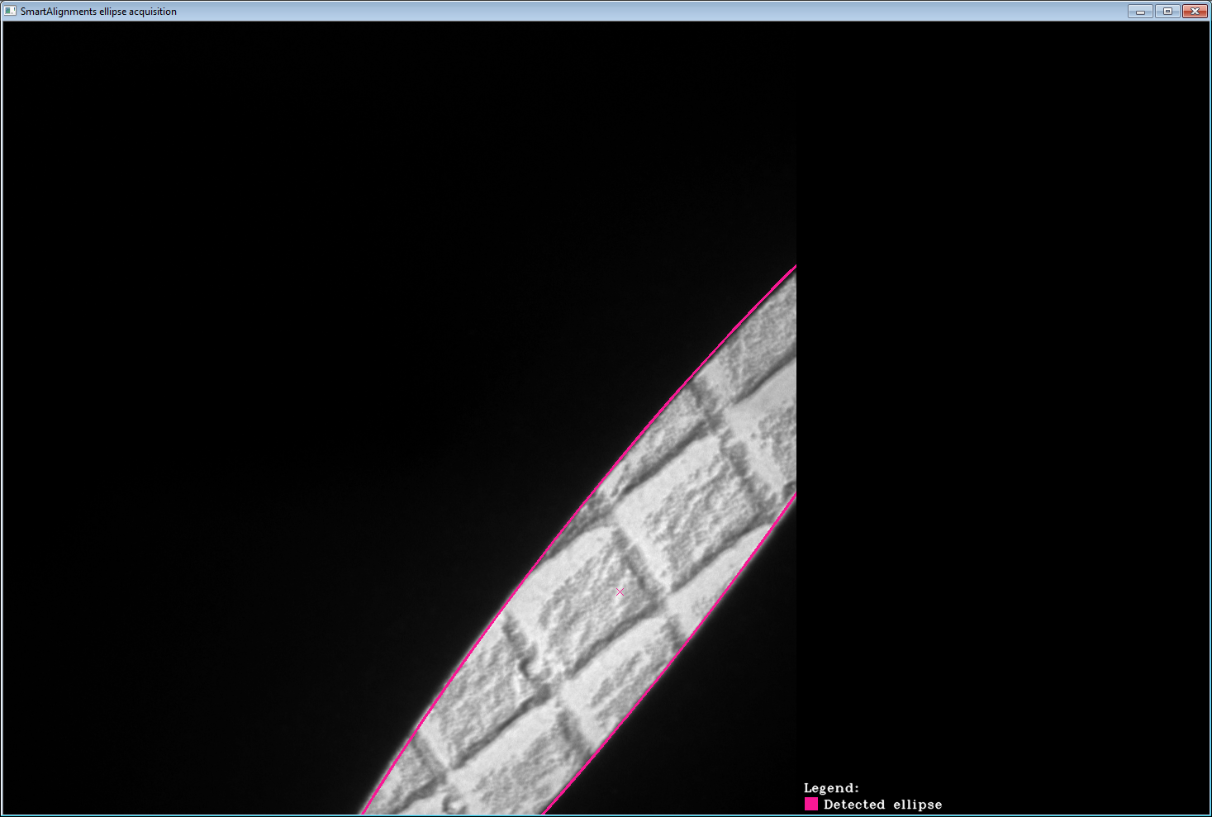
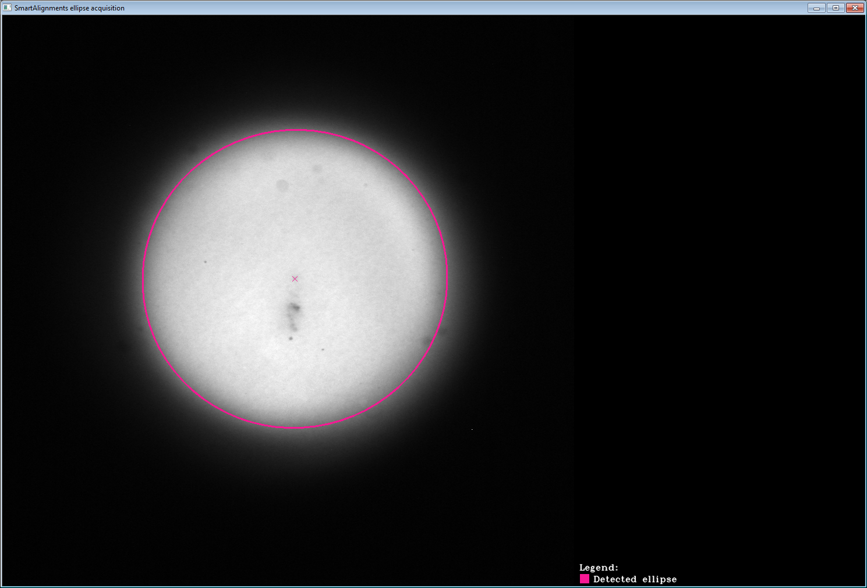
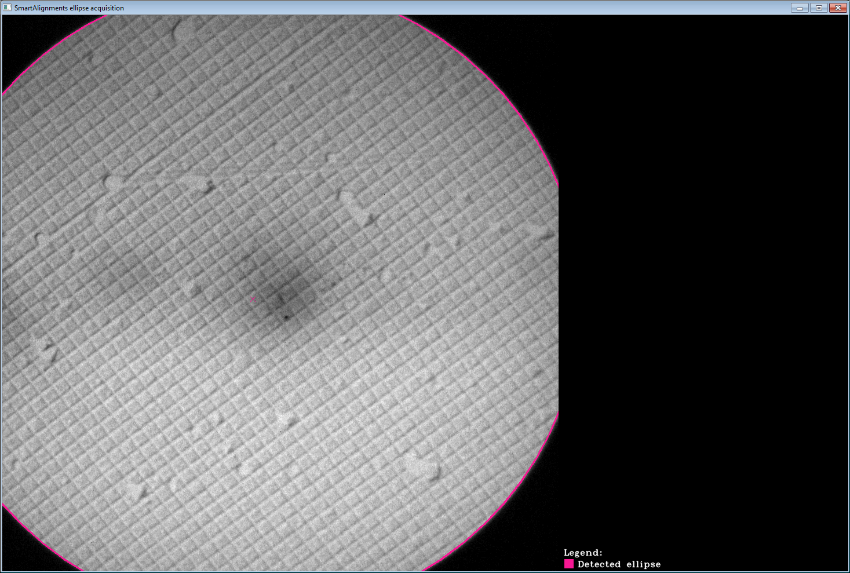
Group 1 – Easy fits

Slide 9
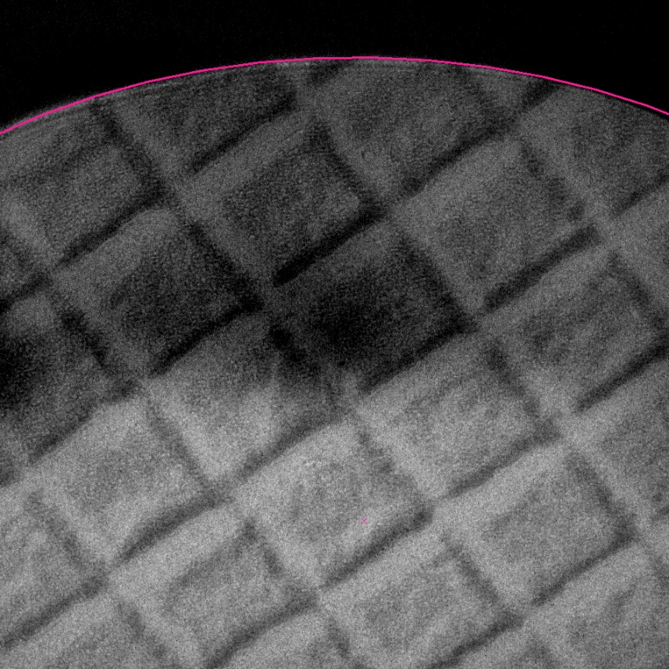
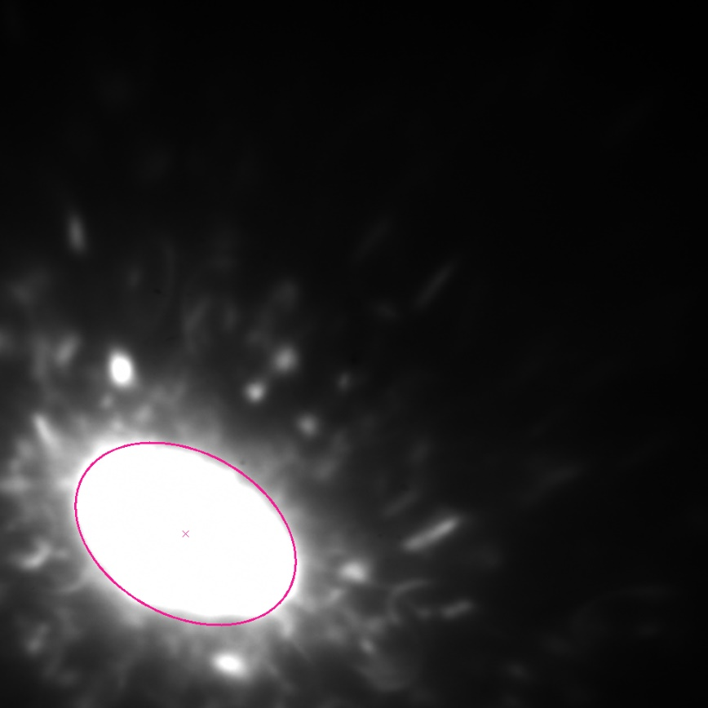
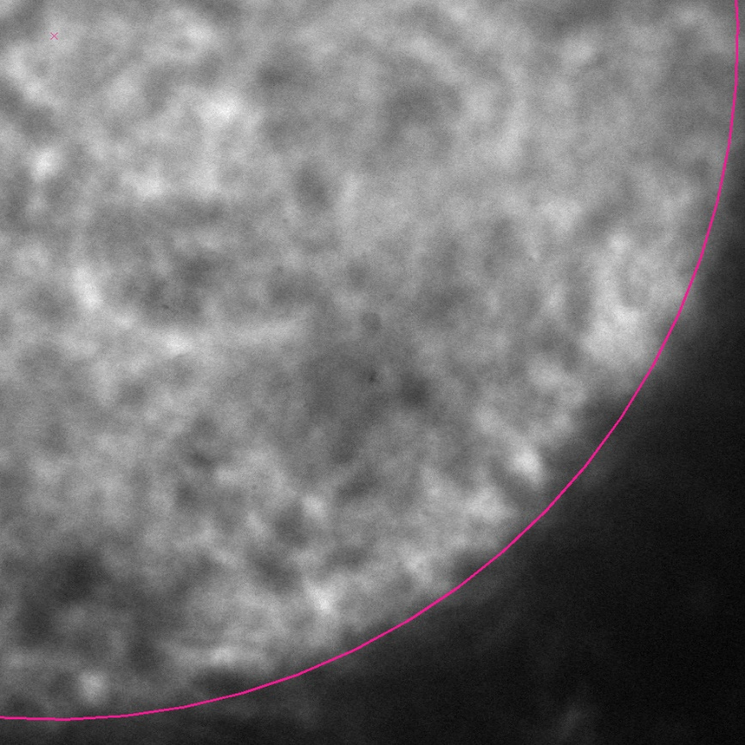
Group 2 – Hardly fittable beams
Diffraction pattern
Primary beam
Fig. bad illumination conditions
Fig. diffraction patterns
Fig. high magnification

Slide 10
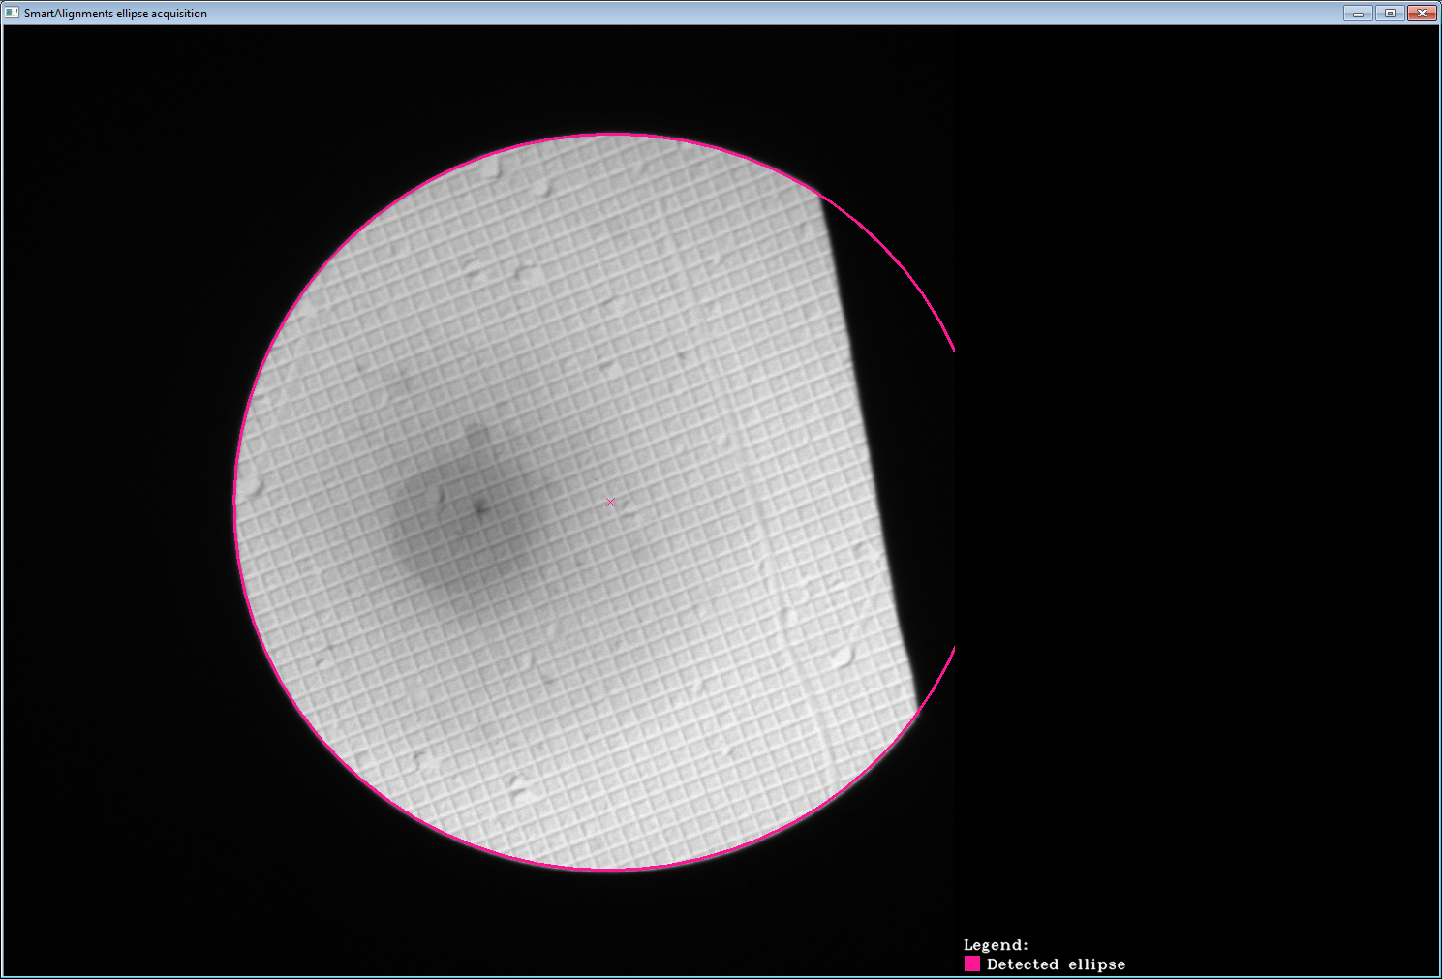
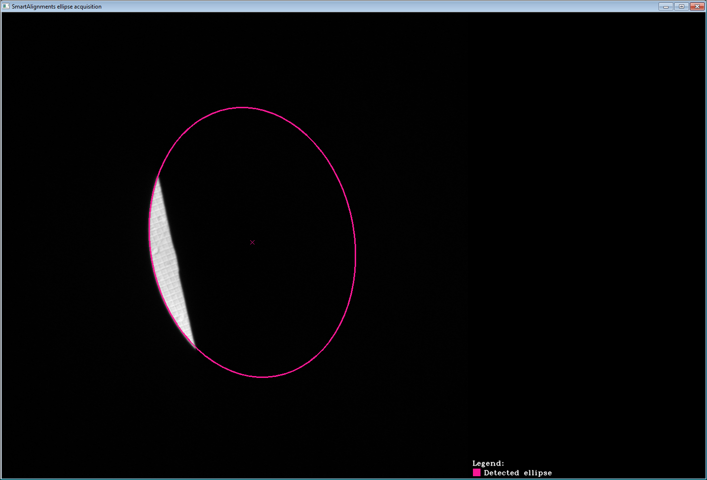
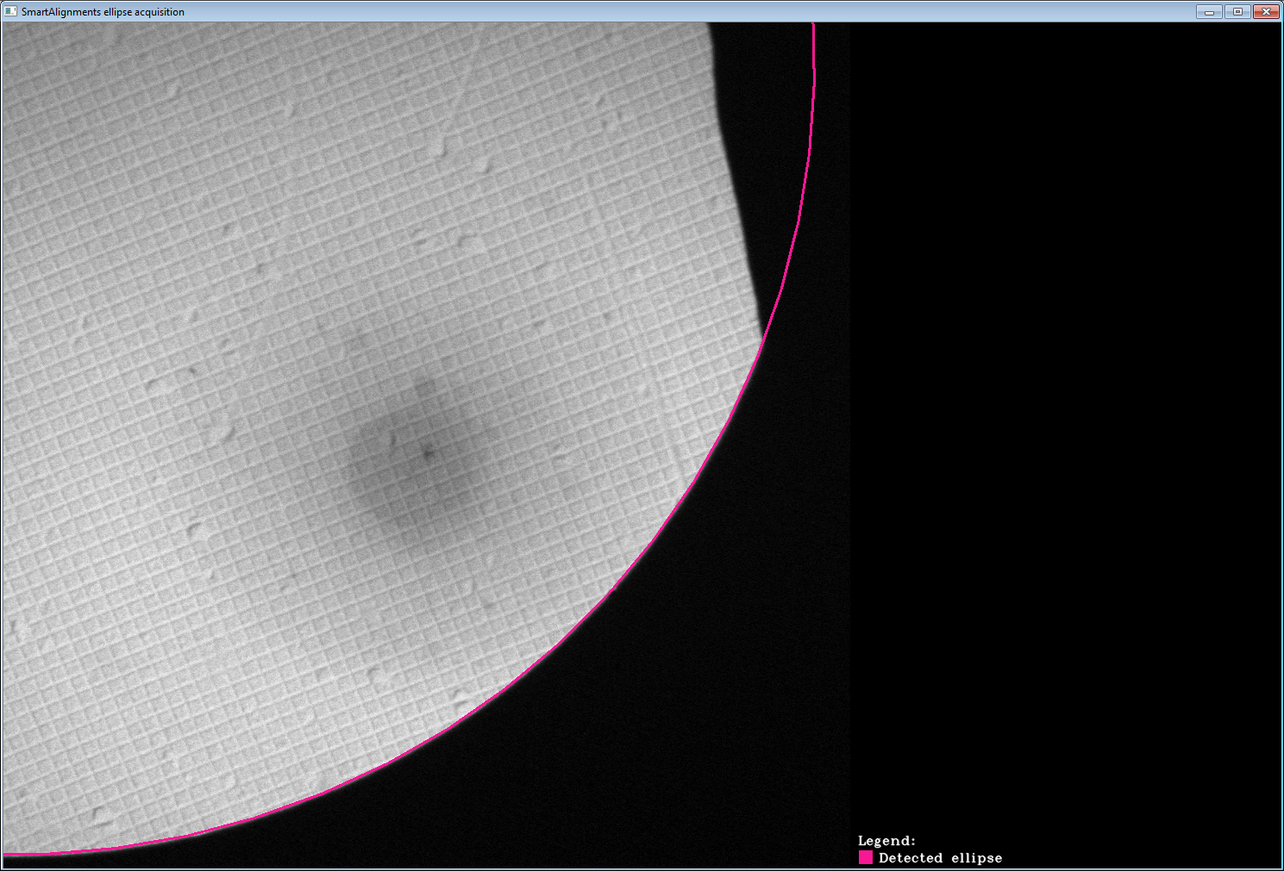
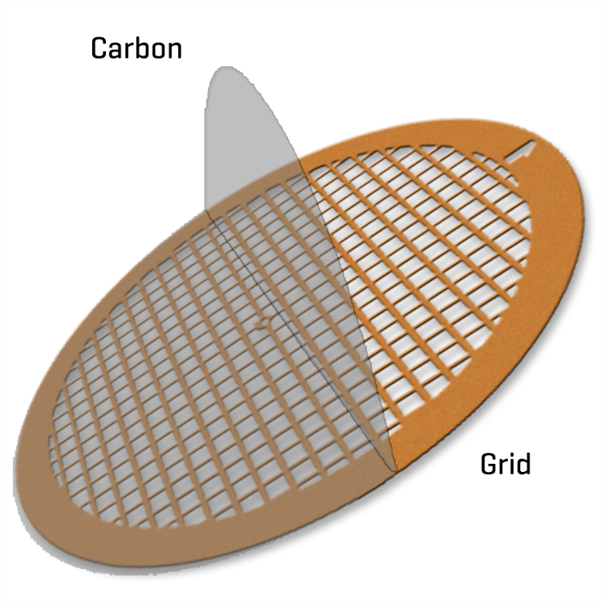
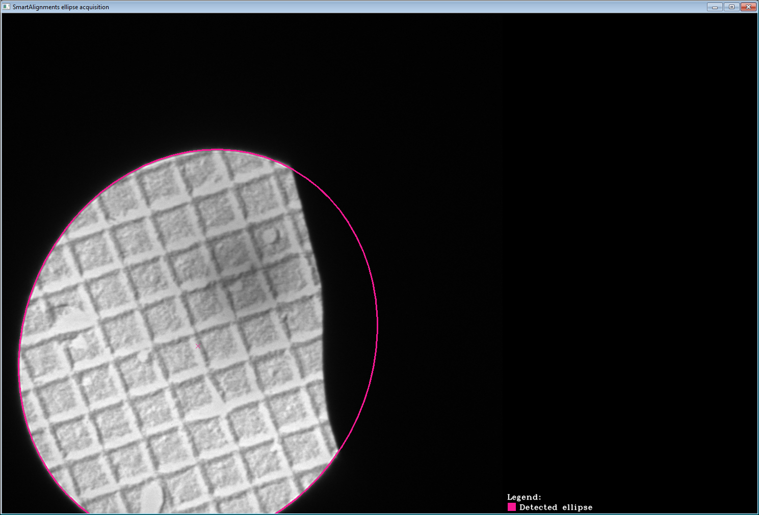
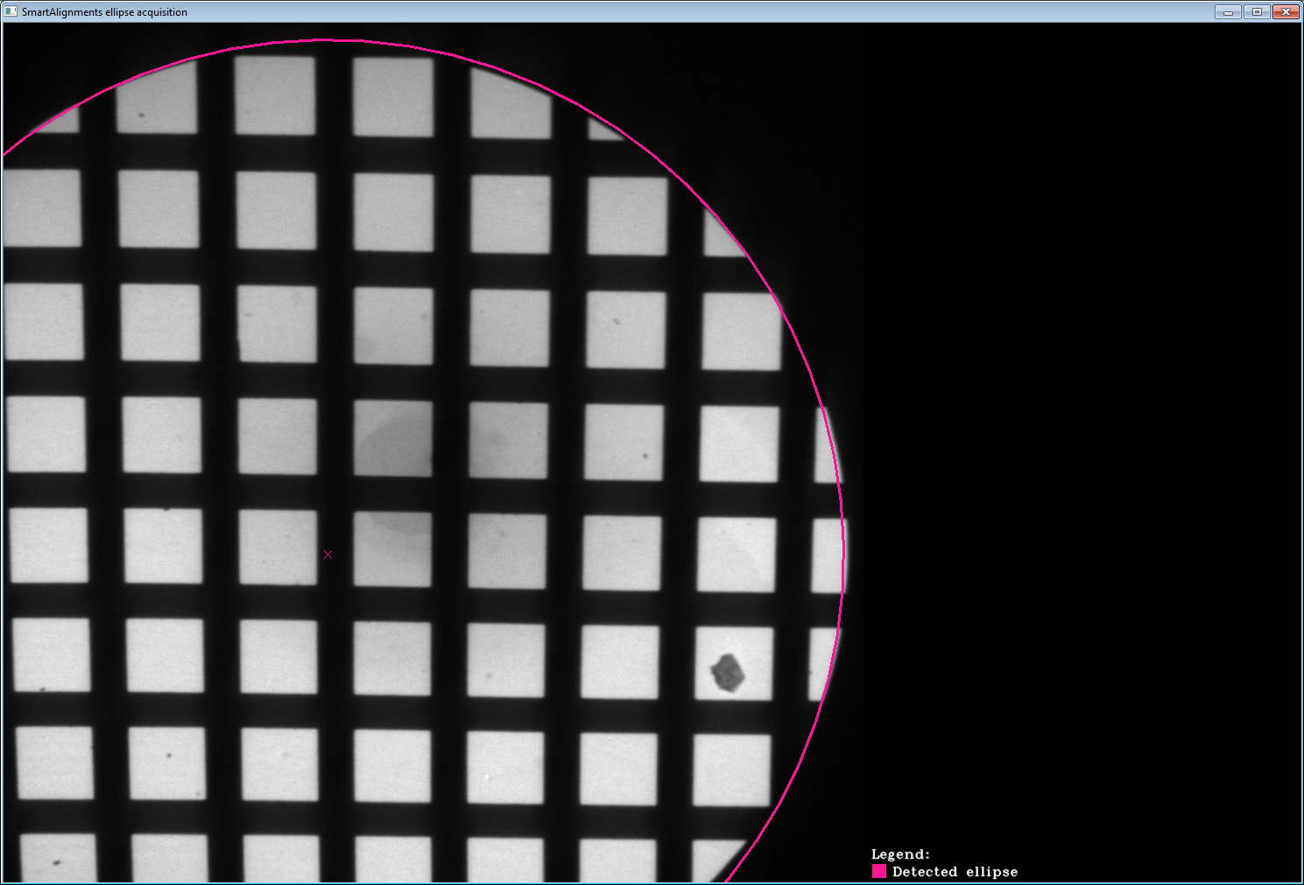
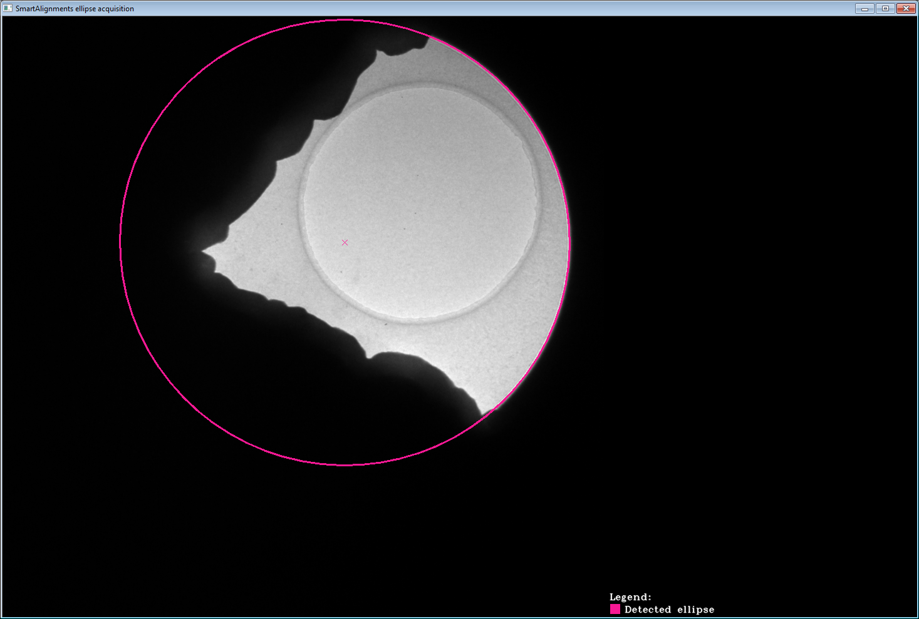
Group 3 –TEM grid oclusions
The examined sample is laid on a carbon foil supported by a copper grid.
Copper is not transparent for electrons, therefore the electron beam may be cut by a grid causing linear cut-offs.
Grid cut-offs should not affect the ellipse fit precision.
Beam contour cut-off
Grid cut-off
Fig: TEM carbon foil supported by a coper grid

Slide 11
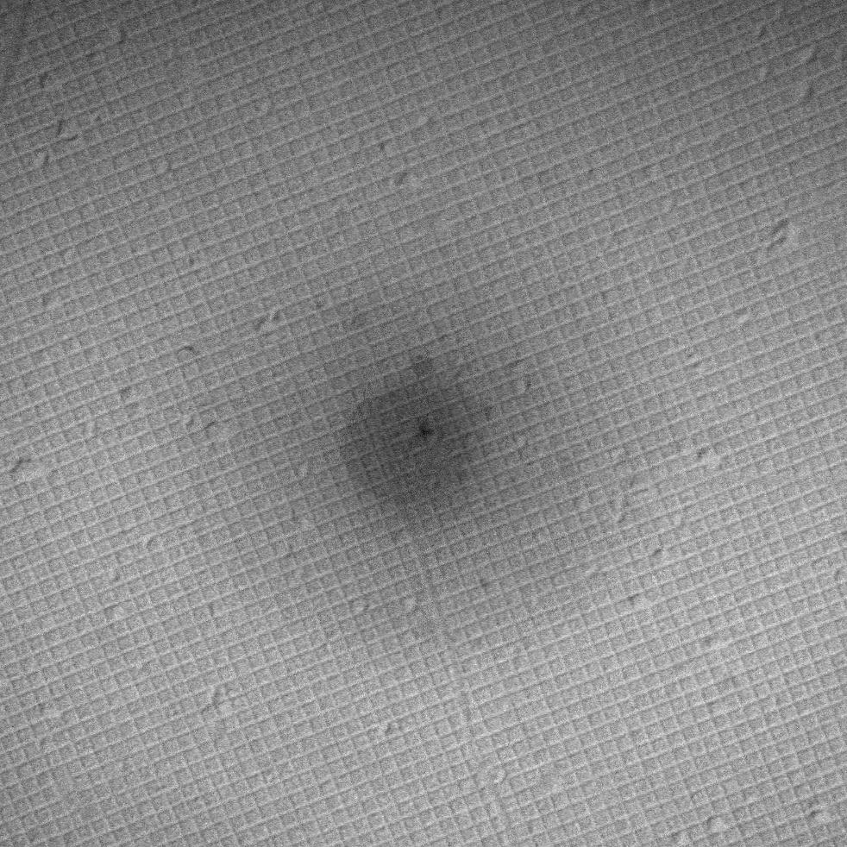

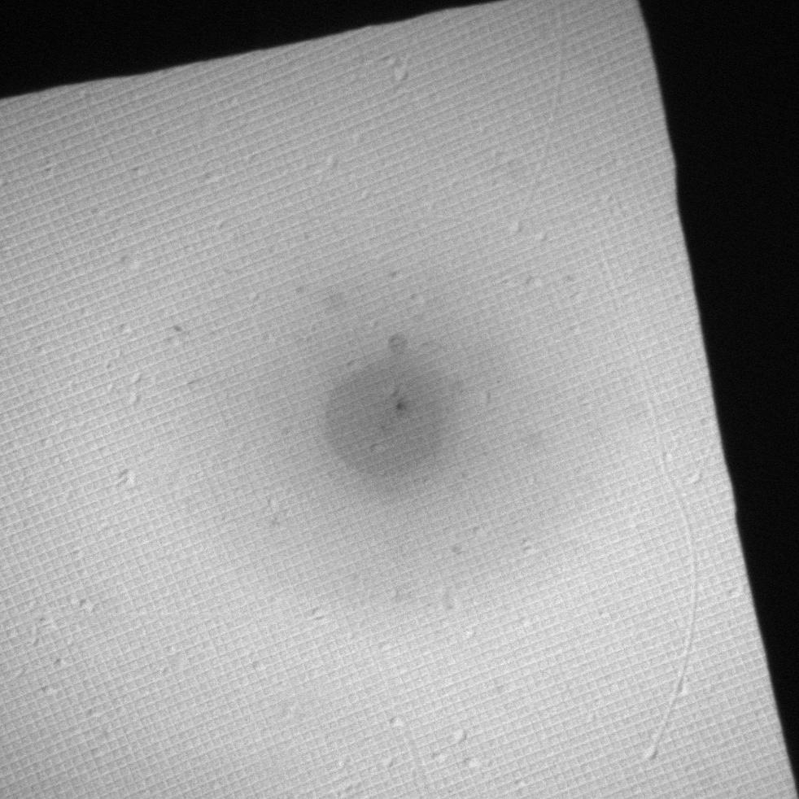
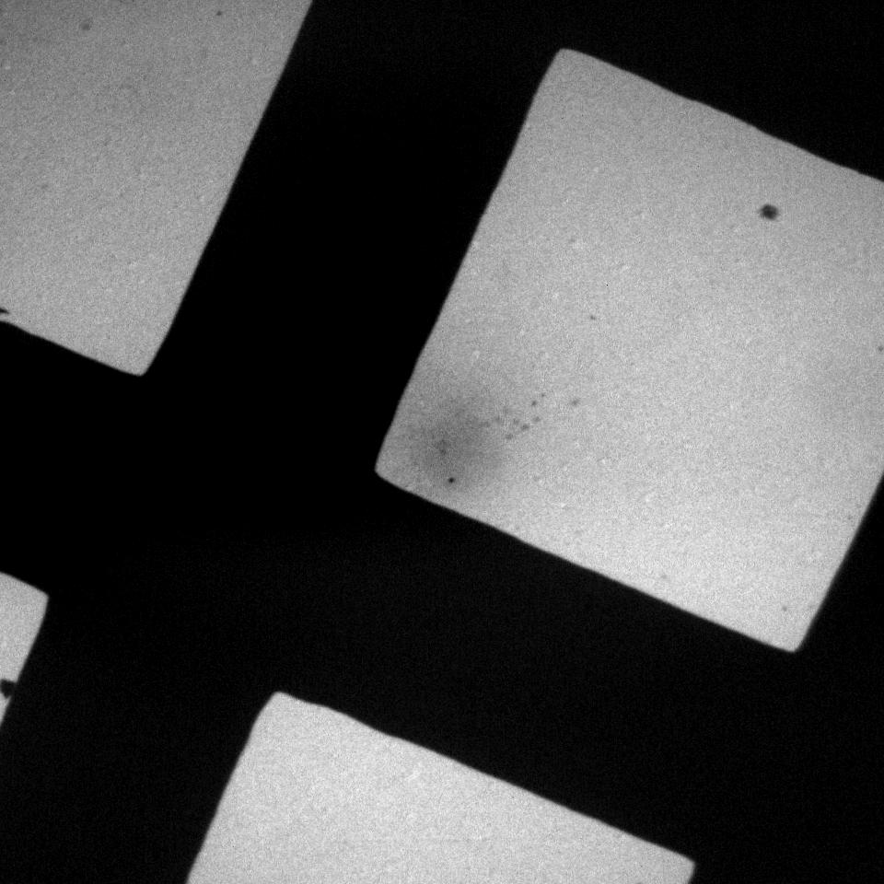
Group 4 – screen illumiantion modes (fully illuminated screen, no illumination)
The goal is to recognize that there is no beam border visible and an ellipse, therefore, can not be fitted.
There are three types of illuminations in this group:
fully illuminated screen: the beam is spread all over the field of view (FOV) → no ellipse can be fitted
no illumination: the beam is completely out of FOV → no ellipse can be fitted
fully illuminated screen + grid occlusion: background/dark pixels are caused only by grid occlusion → no ellipse can be fitted
Fig. fully illuminated screen
Fig. no illumination
Fig. fully illuminated screen + grid cut-off

Slide 12
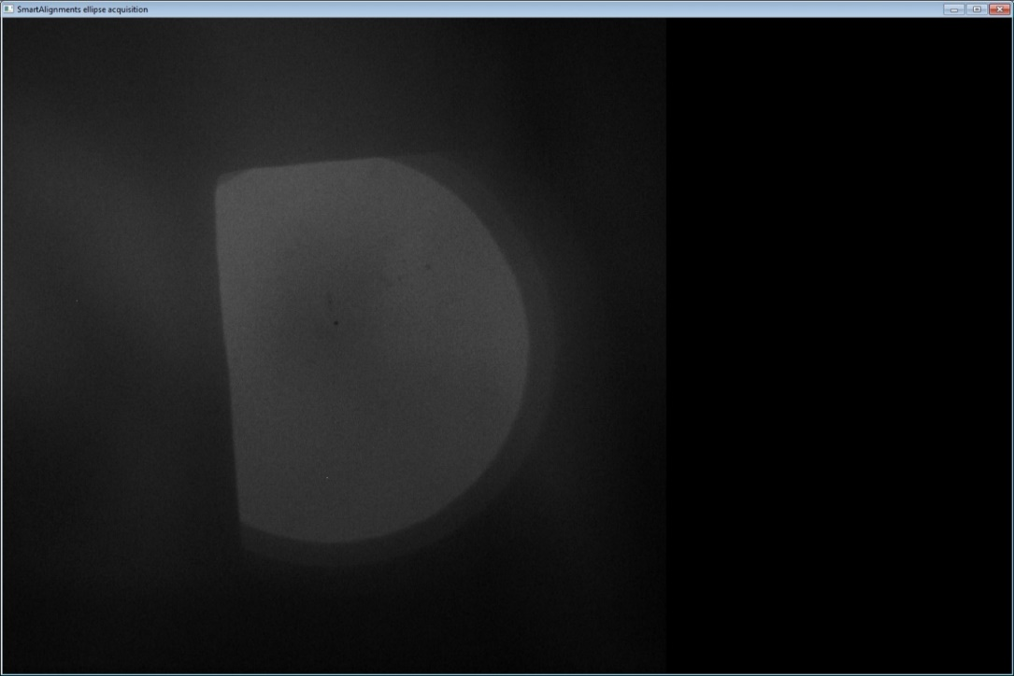
Group 5 – Screen illumiantion modes (afterglows, off-screen scatterings)
The goal is to recognize that there is no beam border visible even if there is some (often not negligible) illumination. These illuminations are mainly caused by two physical effects – Afterglow and Off-screen scattering
Afterglow:
TEM images are acquired by a CCD camera capturing a fluorescent screen. A fluorescent screen converts the energy of incident electrons to visible light. The fluorescent screen suffers from an undesirable effect called afterglow, emerging after a sudden change in illumination conditions (e.g. after an abrupt shift of beam out of FOV). Due to the time constant of a fluorescent screen, it is „shining“ for a certain period even if the electron beam is completely out of FOV. Although the captured afterglow signal may have similar intensity as „regular illumination“ in certain microscope modes, it has to be recognized as no illumination → no ellipse can be fitted
Electron beam shifted out of FOV
Fig. proper illumination
Fig. afterglow

Slide 13

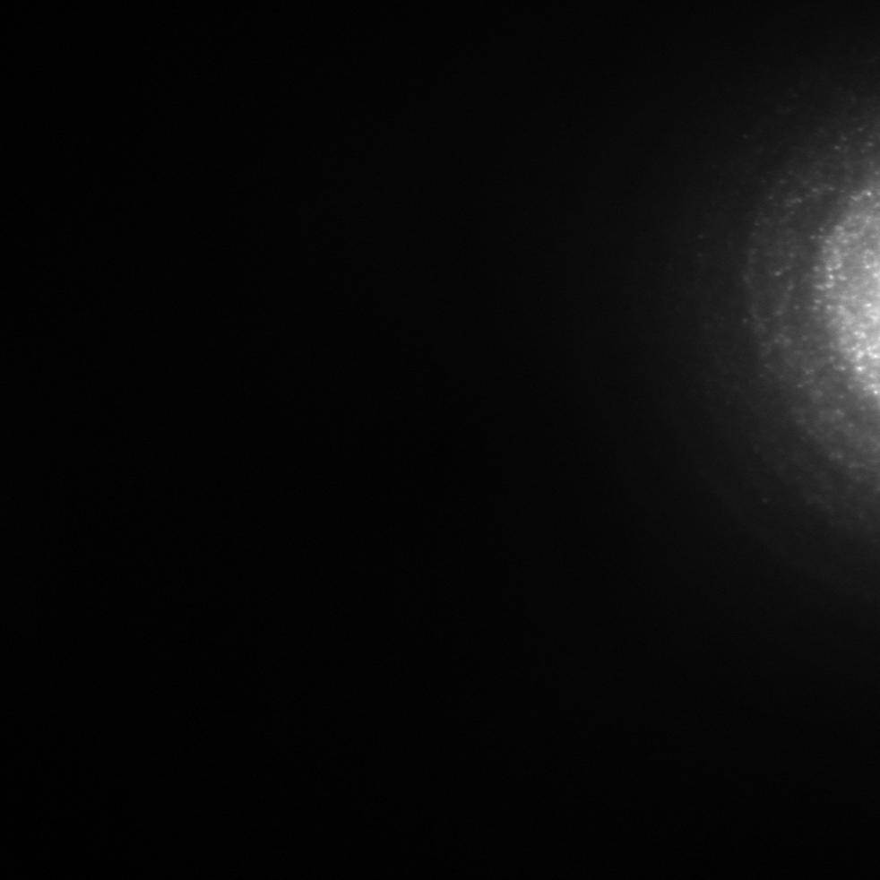
Group 5 – Screen illumiantion modes (afterglows, off-screen scatterings)
The goal is to recognize that there is no beam border visible even if there is some (often not negligible) illumination. These illuminations are mainly caused by the two physical effects – Afterglow and Off-screen scattering
Off-screen scattering:
When setting TEM to a certain microscope mode and illumination conditions, scattering patterns (fog or dots texture) around the primary beam may occur (see left figure). In cases when the primary beam is completely out of FOV but very close to the FOV border, scattering patterns by themselves may occur. As they are not directly related to beam position/shape they must be recognized as parasitic illumination → no ellipse can be fitted
Fig. primary beam + scattering
Fig. off-screen scattering

Slide 14
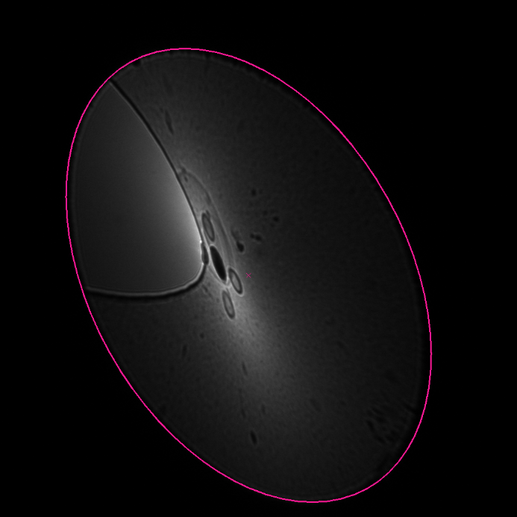
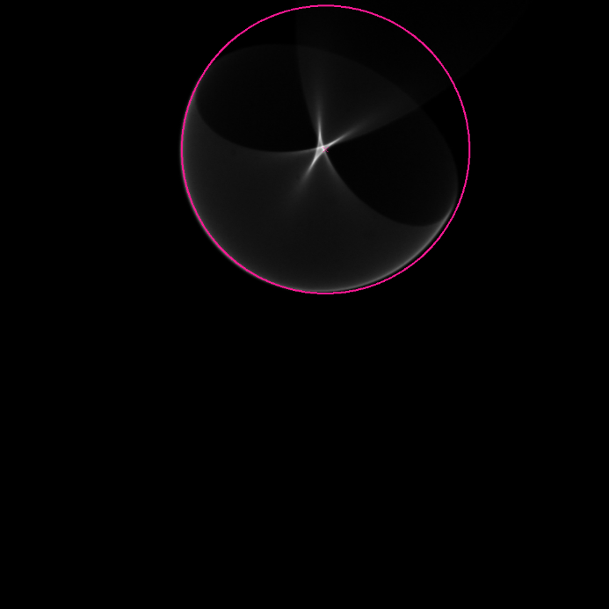
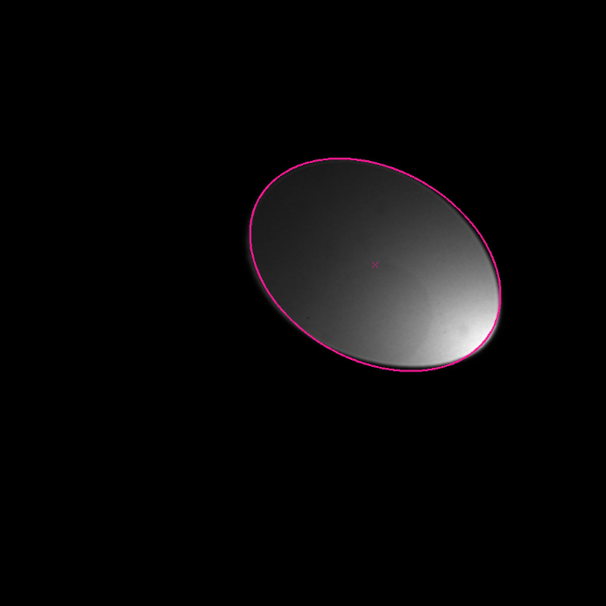
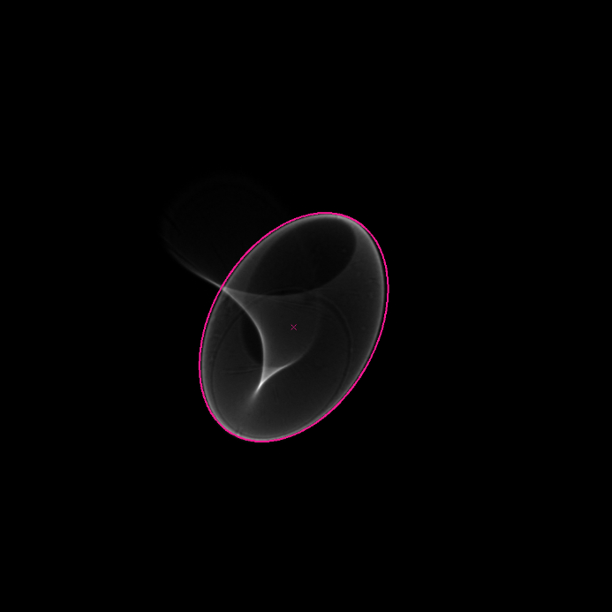
Group 6 – Comatic & Caustic beams
Comatic and caustic beams are characterized by highly uneven illumination originated either by beam tilt in case of comatic beams or folding of the electron wavefront and its subsequent overlap in image in case of caustic beams. Both cases are regular beams, but the uneven illumination is complicating the ellipse fitting.
Fig. comatic beams
Fig. caustic beams

Slide 15
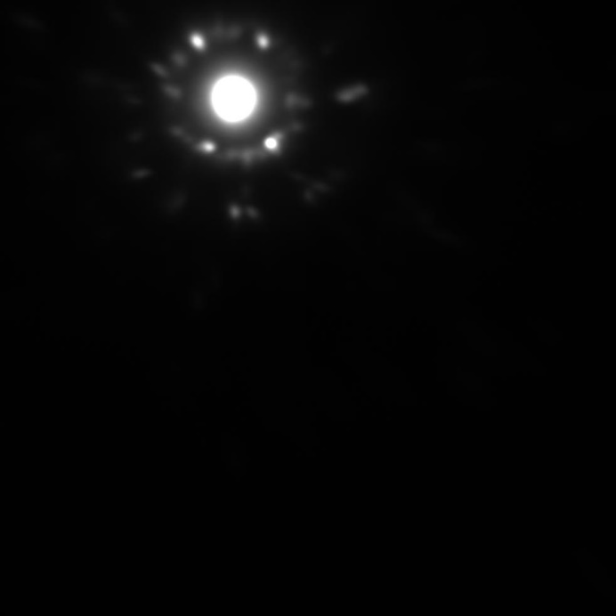
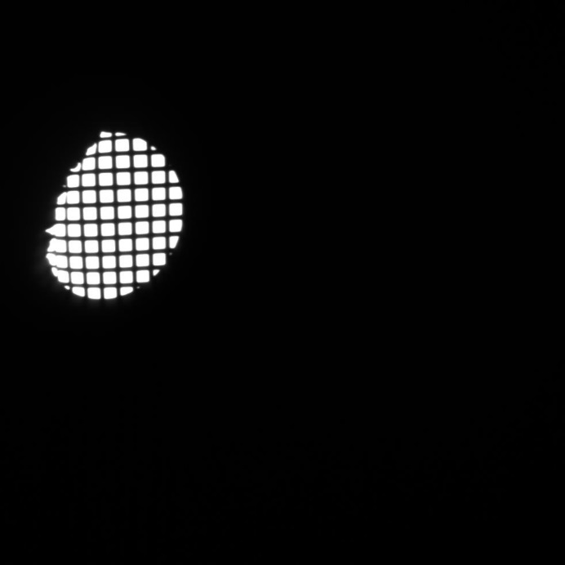
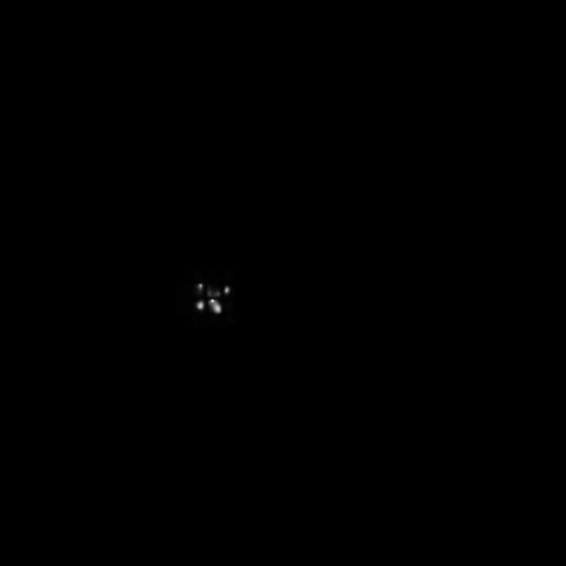




Group 7 – Generally hard cases

